Slide 1


Slide 2
PRAYER ALARM
PRESENTED BY:
HUZAIFA SHAHBAZ 21-CE-009

Slide 3
OUTLINES
Abstract
Introduction
Objective
Problem Statement
Expected Outcome
Components Used
Android Studio Jellyfish

Slide 4
OUTLINES (CONTINUED)
AVD Emulator
JAVA
XML IN LINEAR LAYOUT
Functional Requirements
Non-Functional Requirements
Main Activities of prayer and Codes
Multiplies Activities and Intent and Codes
LIST VIEW AND ARRAY ADAPTER AND CODES
LIST VIEW AND BASE ADAPTER AND CODES
SHARED PREFERENCES
VIEW PAGER
CONCLUSION

Slide 5
Abstract
An app called Prayer Alarm is presented as a way for Muslim people to remember to pray every day even when they have a lot of work to do.
By utilizing personalized alerts and inspirational elements, it seeks to promote spiritual awareness in addition to intellectual endeavors.
The project aims to improve consumers' overall well-being while satisfying a technological requirement.

Slide 6
Introduction
It can be difficult to recall daily prayers in our hectic academic lives.
An approachable smartphone app to remind students of prayer times is provided by the Prayer Alarm initiative as a remedy.
It encourages spiritual mindfulness in addition to academic endeavors with its motivational elements and individualized notifications.
Our goal is to develop a product that enhances users' overall wellbeing while also meeting a technological necessity.
Come along with us as we set out to balance spiritual commitment with academic excellence.

Slide 7
Objective
The Prayer Alarm project aims to create a mobile application that serves as a reminder for students to pray every day, promoting spiritual attention in the midst of academic obligations.
It strives to encourage regularity in prayer practice with features that are adjustable for notifications and motivation.
The goal of the initiative is to give students a tool that fits in well with their daily routines and helps them better manage their time between spirituality and academic brilliance.
Through tackling the difficulty of recalling prayers, it seeks to enhance users' overall health and spiritual satisfaction.

Slide 8
Problem Statement
The challenge of students remembering daily prayers in the middle of busy academic schedules is the issue that the Prayer Alarm project attempts to solve.
As a result, spiritual obligations are neglected and there is inconsistency.
Reminder systems that are already in use frequently lack personalization and struggle to fit in with students' daily routines.
As a result, a lot of students find it difficult to keep a healthy balance between their spiritual and intellectual endeavors.
By offering a user-friendly solution that is customized to meet the needs of Muslim’s people, The Prayer Alarm aims to close this gap and promote a harmonious integration of academic and spiritual life.

Slide 9
Expected Outcome
Muslim Students who participate in the Prayer Alarm initiative should be equipped to continue praying every day in a deliberate and regular manner.
Muslim Students will find it easier to fit their spiritual responsibilities into their hectic academic schedules by using the application.
Increased spiritual contentment, better time management abilities, and a better feeling of balance between one's personal and academic lives are expected outcomes of this.
In the end, the Prayer Alarm hopes to support students' overall wellbeing by encouraging a closer relationship with their faith while they work toward their academic objectives.

Slide 10
Components Used
The components used in prayer alarm system are
Android studio Iguana
AVD Emulator
Java
Linear layout in XML

Slide 11
Android Studio
Android Studio is the main integrated development environment (IDE) for creating Android apps, and it is based on IntelliJ IDEA.
It provides an extensive toolkit for creating, writing, testing, and debugging Android apps.
It simplifies the app creation process with features like visual layout editor, code completion, and easy connection with the Android SDK.
Developers are able to test programs on a variety of virtual devices thanks to its powerful emulator.
Multiple programming languages, such as Java and Kotlin, are supported by Android Studio, enabling developers to construct inventive and feature-rich Android apps.

Slide 12
AVD Emulator
Without requiring actual devices, Android applications can be tested in a virtual environment with the help of the Android Virtual Device (AVD) emulator.
Different device configurations, including screen size, resolution, and Android version, can be simulated by developers.
To ensure compatibility and dependability, developers can test an alarm's performance across several virtual devices using the AVD emulator when creating a prayer alarm app.
It improves the overall performance of the program by making debugging and fine-tuning its behavior under various circumstances easier.
Because it offers a handy platform for iterative testing and improvement of the prayer alarm app, the AVD emulator speeds up the development process.

Slide 13
JAVA
Java classes and methods can be used to construct a prayer alarm that manages event scheduling and triggers at certain periods.
With classes like as `Timer` or `ScheduledExecutorService`, programmers can configure recurring tasks to trigger the alert.
User interactions and audio playback may require integration with platform-specific APIs.
Furthermore, the integration of date and time utilities facilitates the accurate scheduling of alarms for prayer.
By addressing any mistakes that might arise during the setup or operation of an alarm, exception handling guarantees dependability.
Finally, when developing a Java-based prayer alarm application, modular design and encapsulation facilitate code readability and maintainability.

Slide 14
XML IN LINEAR LAYOUT
The prayer alarm user interface (UI) can be organized in XML with a Linear Layout, featuring views for selecting the time, alarm setting toggles, and customization options.
Within the linear layout, attributes such as `layout_width} and `layout_height} dictate the dimensions and orientation of views.
Users can set alarm times and enable/disable alarms with widgets like Time Picker and Switch.
Furthermore, Text-Views have the ability to name UI elements, assisting users in setting up alarms.
Buttons can initiate actions such as saving alarm settings or closing the alarm configuration screen by using the {onClick} properties.
Last but not least, setting {orientation} to "vertical" guarantees a layout that is stacked vertically, making it easier for users to interact with the prayer alarm interface.

Slide 15
FUNCTIONAL REQUIREMENTS
Alarm Setting
CUSTOMIZATION
REPEAT OPTIONS
SNOOZE FUNCTIONALITY
SLIENT MODE HANDLING
AUTOMATIC TIMEZONE ADJUSTMENT
NOTIFICATION HANDLING
ACCESSIBILITY FEATURES
INTEGRATION WITH CALENDAR
BACKUP AND RESTORE
MULTIPLE LANGUAGE SUPPORT
OFFLINE FUNCTIONALITY

Slide 16
NON-FUNCTIONAL REQUIREMENTS
PERFORMANCE
REALIABILITY
USABILITY
ACCESSIBILITY
Security
Compatibility
Maintainability
Availability
Efficiency
Localization

Slide 17
Main Activities and Codes
The Prayer Alarm app accommodates a variety of religious customs by providing a customized reminder for prayer times.
By providing their location and religious affiliation, users enable the app to generate precise prayer schedules.
With features like silent mode for subtle reminders, the app makes sure that prayer routines are followed without interfering.
Within the app, users can access additional resources including prayer guides and religious texts.
By allowing users to interact with other believers and exchange prayer experiences, it promotes a sense of community.
All in all, Prayer Alarm's smooth interface and extensive features encourage spiritual discipline and attentiveness.

Slide 18
JAVA CODE OF Main Activities
package com.huzaifashahbaz.prayeralaramapp; import android.app.AlarmManager; import android.app.PendingIntent; import android.content.Context; import android.content.Intent; import android.os.Bundle; import android.widget.Button; import android.widget.EditText; import android.widget.TextView; import android.widget.Toast; import androidx.appcompat.app.AppCompatActivity; import java.util.Calendar; public class MainActivity extends AppCompatActivity { private EditText editTextTime; private Button buttonSetAlarm; private TextView textViewStatus; private AlarmManager alarmManager; private PendingIntent pendingIntent; @Override protected void onCreate(Bundle savedInstanceState) { super.onCreate(savedInstanceState); setContentView(R.layout.activity_main); editTextTime = findViewById(R.id.editTextTime); buttonSetAlarm = findViewById(R.id.buttonSetAlarm); textViewStatus = findViewById(R.id.textViewStatus); alarmManager=(AlarmManager)

Slide 19
JAVA CODE OF Main Activities(Continued)
getSystemService(Context.ALARM_SERVICE); buttonSetAlarm.setOnClickListener(v-> setAlarm()); } private void setAlarm() { String time=editTextTime.getText().toString(); if (time.isEmpty()) { Toast.makeText(this, "Please enter a time", Toast.LENGTH_SHORT).show(); return; } String[] timeParts=time.split(":"); if (timeParts.length!=2) { Toast.makeText(this, "Invalid time format", Toast.LENGTH_SHORT).show(); return; } int hour,minute; try { hour=Integer.parseInt(timeParts[0]); minute=Integer.parseInt(timeParts[1]); } catch (NumberFormatException e) {

Slide 20
JAVA CODE OF Main Activities(Continued)
Toast.makeText(this, "Invalid time format", Toast.LENGTH_SHORT).show(); return; } Calendar calendar=Calendar.getInstance(); calendar.set(Calendar.HOUR_OF_DAY,hour); calendar.set(Calendar.MINUTE,minute); calendar.set(Calendar.SECOND,0); Intent intent=new Intent(this,AlarmReceiver.class); alarmManager.setExact(AlarmManager.RTC_WAKEUP,calendar.getTimeInMillis(),pendingIntent); textViewStatus.setText("Alarm set for"+time); Toast.makeText(this, "Alarm set for", Toast.LENGTH_SHORT).show(); } }

Slide 21
XML CODE OF Main Activities
<?xml version="1.0" encoding="utf-8"?> <LinearLayout xmlns:tools="http://schemas.android.com/tools" xmlns:android="http://schemas.android.com/apk/res/android" xmlns:app="http://schemas.android.com/apk/res-auto" android:layout_width="match_parent" android:layout_height="match_parent" android:orientation="vertical" android:padding="16dp"> <EditText
android:id="@+id/editTextTime" android:layout_width="match_parent" android:layout_height="wrap_content" android:hint="Enter prayer time(HH:MM)" android:inputType="time" android:padding="16dp"/> <Button android:id="@+id/buttonSetAlarm" android:layout_width="match_parent" android:layout_height="wrap_content" android:text="Set Alarm" android:padding="16dp"/>

Slide 22
XML CODE OF Main Activities(Continued)
<TextView android:id="@+id/textViewStatus" android:layout_width="match_parent" android:layout_height="wrap_content" android:text="" android:padding="16dp"/> </LinearLayout>

Slide 23
JAVA CODE OF Alarm Receiver
package com.huzaifashahbaz.prayeralaramapp; import android.content.BroadcastReceiver; import android.content.Context; import android.content.Intent; import android.media.Ringtone; import android.media.RingtoneManager; import android.net.Uri; import android.widget.Toast; public class AlarmReceiver extends BroadcastReceiver { @Override public void onReceive(Context context, Intent intent) { Uri alarmUri= RingtoneManager.getDefaultUri(RingtoneManager.TYPE_ALARM); if (alarmUri==null) { alarmUri=RingtoneManager.getDefaultUri(RingtoneManager.TYPE_NOTIFICATION); }
Ringtone ringtone=RingtoneManager.getRingtone(context,alarmUri); ringtone.play(); } }

Slide 24
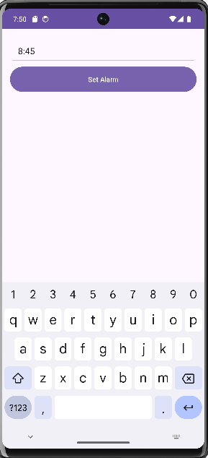
OUTPUT OF MAIN ACTIVITY

Slide 25
MULTIPLE ACTIVITES AND INTENTS AND CODES
The Prayer Alarm app is a flexible tool for spiritual practice that easily incorporates a number of different activities.
It enables users to program personalized alarms for prayer times, with uplifting messages and subdued reminders to promote regular devotion.
Users can easily move through a variety of prayer routines and access materials like scripture readings and meditation prompts thanks to the user-friendly interface.
In order to ensure accuracy and inclusivity, the app also provides insights into prayer schedules based on geographic location and religious preferences.
In general, it helps people develop a closer spiritual bond and gives them the tools to practice mindfulness and devotion every day.

Slide 26
JAVA CODE OF MAIN ACTIVITY INTENT
package intent; import android.app.AlarmManager; import android.app.PendingIntent; import android.content.Context; import android.content.Intent; import android.os.Bundle; import android.widget.Button; import android.widget.TextView; import android.widget.TimePicker; import android.widget.Toast; import androidx.appcompat.app.AppCompatActivity; import com.huzaifashahbaz.prayeralaramapp.AlarmReceiver; import com.huzaifashahbaz.prayeralaramapp.R; import java.util.Calendar; public class MainActivity extends AppCompatActivity { private TimePicker timePicker; private Button buttonSetAlarm; private TextView textViewStatus; private AlarmManager alarmManager; private PendingIntent pendingIntent; @Override protected void onCreate(Bundle savedInstanceState) { super.onCreate(savedInstanceState);

Slide 27
JAVA CODE OF MAIN ACTIVITY INTENT(Continued)
setContentView(R.layout.activity_mainintent); timePicker=findViewById(R.id.timePicker); buttonSetAlarm=findViewById(R.id.buttonSetAlarm); textViewStatus=findViewById(R.id.textViewStatus); alarmManager=(AlarmManager) getSystemService(Context.ALARM_SERVICE); buttonSetAlarm.setOnClickListener(v -> setAlarm()); } private void setAlarm() { int hour=timePicker.getCurrentHour(); int minute=timePicker.getCurrentMinute(); Calendar calendar=Calendar.getInstance(); calendar.set(Calendar.HOUR_OF_DAY,hour); calendar.set(Calendar.MINUTE,minute); calendar.set(Calendar.SECOND,0); Intent intent=new Intent(this, AlarmReceiver.class); pendingIntent=pendingIntent.getBroadcast(this,0,intent,PendingIntent.FLAG_UPDATE_CURRENT); alarmManager.setExact(AlarmManager.RTC_WAKEUP,calendar.getTimeInMillis(),pendingIntent); String alarmTime=String.format("%02d:%02d",hour,minute); textViewStatus.setText("Alarm set for"+alarmTime); Toast.makeText(this, "Alarm set for", Toast.LENGTH_SHORT).show(); } }

Slide 28
XML CODE OF MAIN ACTIVITY INTENT
<?xml version="1.0" encoding="utf-8"?> <LinearLayout xmlns:android="http://schemas.android.com/apk/res/android" xmlns:tools="http://schemas.android.com/tools" xmlns:app="http://schemas.android.com/apk/res-auto" android:orientation="vertical" android:layout_width="match_parent" android:layout_height="match_parent" android:padding="16dp"> <TimePicker android:id="@+id/timePicker" android:layout_width="match_parent" android:layout_height="wrap_content" android:layout_gravity="center_horizontal" android:layout_marginBottom="20dp" android:padding="16dp" android:timePickerMode="spinner" /> <Button android:id="@+id/buttonSetAlarm" android:layout_width="match_parent" android:layout_height="wrap_content" android:text="Set Alarm" android:padding="16dp"/> <TextView android:id="@+id/textViewStatus"

Slide 29
XML CODE OF MAIN ACTIVITY INTENT(Continued)
android:layout_width="match_paren" android:layout_height="wrap_conten" android:text="" android:padding="16dp"/> </LinearLayout>

Slide 30
JAVA CODE OF Alarm Receiver
package com.huzaifashahbaz.prayeralaramapp; import android.content.BroadcastReceiver; import android.content.Context; import android.content.Intent; import android.media.Ringtone; import android.media.RingtoneManager; import android.net.Uri; import android.widget.Toast; public class AlarmReceiver extends BroadcastReceiver { @Override public void onReceive(Context context, Intent intent) { Uri alarmUri= RingtoneManager.getDefaultUri(RingtoneManager.TYPE_ALARM); if (alarmUri==null) { alarmUri=RingtoneManager.getDefaultUri(RingtoneManager.TYPE_NOTIFICATION); }
Ringtone ringtone=RingtoneManager.getRingtone(context,alarmUri); ringtone.play(); } }

Slide 31
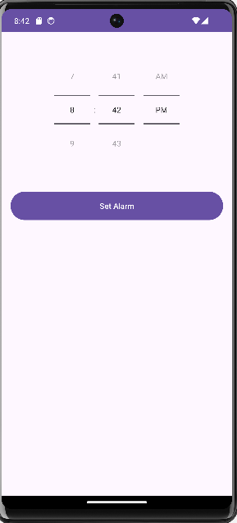
OUTPUT OF INTENT

Slide 32
LIST VIEW AND BASE ADAPTER AND CODES
An Android UI element called a List View shows a list of scrollable elements arranged vertically.
Developers can specify how data is shown by creating custom adapters for List Views using the Base-Adapter abstract class.
A Base-Adapter can be used to alter the appearance and functionality of each item in an alarm clock app, such as the prayer time display and alarm setting capabilities.
A List View can present a list of prayer times.
This combination makes it easier to manage alarms and prayer routines with an intuitive interface.

Slide 33
JAVA CODE OF LIST VIEW AND BASE ADAPTER
package BASEADAPTERANDLISTVIEW; import android.annotation.SuppressLint; import android.app.AlarmManager; import android.app.PendingIntent; import android.content.Context; import android.content.Intent; import android.os.Bundle; import android.widget.Button; import android.widget.ListView; import android.widget.TextView; import android.widget.Toast; import androidx.appcompat.app.AppCompatActivity; import com.huzaifashahbaz.prayeralaramapp.R; import java.util.Calendar; public class MainActivity extends AppCompatActivity { private ListView listViewPrayers; private Button buttonSetAlarm; private TextView textViewStatus; private AlarmManager alarmManager; private PendingIntent pendingIntent; private PrayerTimeAdapter adapter; private String[] prayerTimes = {"3:20", "12:05", "5:03", "7:11", "8:52"}; @Override protected void onCreate(Bundle savedInstanceState) { super.onCreate(savedInstanceState); setContentView(R.layout.activity_main); listViewPrayers = findViewById(R.id.listViewPrayers);

Slide 34
JAVA CODE OF LIST VIEW AND BASE ADAPTER(Continued)
buttonSetAlarm = findViewById(R.id.buttonSetAlarm); textViewStatus = findViewById(R.id.textViewStatus); alarmManager = (AlarmManager) getSystemService(Context.ALARM_SERVICE); adapter = new PrayerTimeAdapter(this, prayerTimes); listViewPrayers.setAdapter(adapter); buttonSetAlarm.setOnClickListener(v -> setAlarm()); } private void setAlarm() { String selectedTime = adapter.getSelectedTime(); if (selectedTime == null) { Toast.makeText(this, "Please select a prayer time", Toast.LENGTH_SHORT).show(); return; } String[] timeParts = selectedTime.split(":"); int hour = Integer.parseInt(timeParts[0]); int minute = Integer.parseInt(timeParts[1]); Calendar calendar = Calendar.getInstance(); calendar.set(Calendar.HOUR_OF_DAY, hour); calendar.set(Calendar.MINUTE, minute); calendar.set(Calendar.SECOND, 0); Intent intent = new Intent(this, AlarmReceiver.class); pendingIntent = PendingIntent.getBroadcast(this, 0, intent, PendingIntent.FLAG_UPDATE_CURRENT);

Slide 35
JAVA CODE OF LIST VIEW AND BASE ADAPTER(Continued)
alarmManager.setExact(AlarmManager.RTC_WAKEUP, calendar.getTimeInMillis(), pendingIntent); textViewStatus.setText("Alarm set for " + selectedTime); Toast.makeText(this, "Alarm set for " + selectedTime, Toast.LENGTH_SHORT).show(); } }

Slide 36
XML CODE OF LIST VIEW AND BASE ADAPTER
<?xml version="1.0" encoding="utf-8"?> <LinearLayout xmlns:android="http://schemas.android.com/apk/res/android" xmlns:tools="http://schemas.android.com/tools" xmlns:app="http://schemas.android.com/apk/res-auto" android:orientation="vertical" android:layout_width="match_parent" android:layout_height="match_parent" android:padding="16dp"> <ListView android:id="@+id/listViewPrayers" android:layout_width="match_parent" android:layout_height="0dp" android:layout_weight="1" android:padding="16dp"/> <Button android:id="@+id/buttonSetAlarm" android:layout_width="match_parent“
android:layout_height="wrap_content" android:text="Set Alarm" android:padding="16dp"/> <TextView android:id="@+id/textViewStatus“

Slide 37
XML CODE OF LIST VIEW AND BASE ADAPTER(Continued)
android:layout_width="match_parent“ android:layout_height="wrap_content" android:text="" andrzoid:padding="16dp"/> </LinearLayout>

Slide 38
JAVA CODE OF Alarm Receiver
package com.huzaifashahbaz.prayeralaramapp; import android.content.BroadcastReceiver; import android.content.Context; import android.content.Intent; import android.media.Ringtone; import android.media.RingtoneManager; import android.net.Uri; import android.widget.Toast; public class AlarmReceiver extends BroadcastReceiver { @Override public void onReceive(Context context, Intent intent) { Uri alarmUri= RingtoneManager.getDefaultUri(RingtoneManager.TYPE_ALARM); if (alarmUri==null) { alarmUri=RingtoneManager.getDefaultUri(RingtoneManager.TYPE_NOTIFICATION); }
Ringtone ringtone=RingtoneManager.getRingtone(context,alarmUri); ringtone.play(); } }

Slide 39
JAVA CODE OF PRAYERTIMEADAPTER
package BASEADAPTERANDLISTVIEW; import android.content.Context; import android.view.LayoutInflater; import android.view.View; import android.view.ViewGroup; import android.widget.BaseAdapter; import android.widget.RadioButton; import android.widget.TextView; import com.huzaifashahbaz.prayeralaramapp.R; public class PrayerTimeAdapter extends BaseAdapter { private Context context; private String[] prayerTimes; private int selectedPosition = -1; public PrayerTimeAdapter(Context context, String[] prayerTimes) { this.context = context; this.prayerTimes = prayerTimes; } @Override public int getCount() { return prayerTimes.length; } @Override public Object getItem(int position) {
return prayerTimes[position];}

Slide 40
JAVA CODE OF PRAYERTIMEADAPTER(Continued)
@Override public long getItemId(int position) { return position; } @Override public View getView(int position, View convertView, ViewGroup parent) { ViewHolder holder; if (convertView == null) { convertView = LayoutInflater.from(context).inflate(R.layout.activity_prayer_time_item, parent, false); holder = new ViewHolder(); holder.textViewTime = convertView.findViewById(R.id.textViewTime); holder.radioButton = convertView.findViewById(R.id.radioButton); convertView.setTag(holder); } else { holder = (ViewHolder) convertView.getTag(); } holder.textViewTime.setText(prayerTimes[position]); holder.radioButton.setChecked(position == selectedPosition); convertView.setOnClickListener(v -> { selectedPosition = position;
notifyDataSetChanged();

Slide 41
JAVA CODE OF PRAYERTIMEADAPTER(Continued)
}); return convertView; } public String getSelectedTime() { if (selectedPosition != -1) { return prayerTimes[selectedPosition]; } return null; } private static class ViewHolder { TextView textViewTime; RadioButton radioButton; } }

Slide 42
XML CODE OF PRAYERTIMEADAPTER
<?xml version="1.0" encoding="utf-8"?> <LinearLayout xmlns:android="http://schemas.android.com/apk/res/android" android:orientation="horizontal" android:layout_width="match_parent" android:layout_height="match_parent" android:padding="8dp"> <TextView android:id="@+id/textViewTime" android:layout_width="0dp" android:layout_height="wrap_content" android:layout_weight="1" android:textSize="18sp"/> <RadioButton android:id="@+id/radioButton" android:layout_width="wrap_content" android:layout_height="wrap_content"/> </LinearLayout>

Slide 43
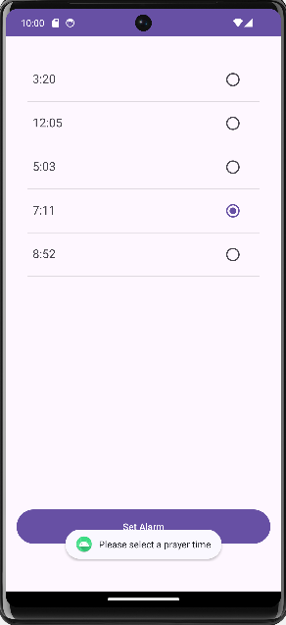
OUTPUT OF PRAYERTIMEADAPTER

Slide 44
Shared Preferences
In Android, key-value pairs are persistently stored in Shared Preferences.
You can utilize Shared choices to store settings for prayer times and alarm choices for prayer alarm apps.
This lets users personalize their alarms and guarantees that their selections stay in effect even after the app is closed.
The software can effectively handle alarm settings by leveraging Shared Preferences, giving users a smooth experience while they participate in their prayer routines.

Slide 45
JAVA CODE OF Shared Preferences
package com.huzaifashahbaz.prayeralarmsharedpreferences; import android.app.AlarmManager; import android.app.PendingIntent; import android.content.Context; import android.content.Intent; import android.content.SharedPreferences; import android.os.Bundle; import android.widget.Button; import android.widget.TextView; import android.widget.TimePicker; import android.widget.Toast; import androidx.appcompat.app.AppCompatActivity; import java.util.Calendar; public class MainActivity extends AppCompatActivity { private TimePicker timePicker; private Button setAlarmButton; private TextView prayerTimeTextView; private static final String PREFS_NAME = "PrayerAlarmPrefs"; private static final String PREF_HOUR = "hour"; private static final String PREF_MINUTE = "minute"; @Override protected void onCreate(Bundle savedInstanceState) { super.onCreate(savedInstanceState); setContentView(R.layout.activity_main); timePicker = findViewById(R.id.timePicker); setAlarmButton = findViewById(R.id.setAlarmButton); prayerTimeTextView = findViewById(R.id.prayerTimeTextView); SharedPreferences preferences = getSharedPreferences(PREFS_NAME, MODE_PRIVATE);

Slide 46
JAVA CODE OF Shared Preferences(Continued)
int hour = preferences.getInt(PREF_HOUR, 0); int minute = preferences.getInt(PREF_MINUTE, 0); updatePrayerTimeTextView(hour, minute); setAlarmButton.setOnClickListener(v -> { int selectedHour = timePicker.getHour(); int selectedMinute = timePicker.getMinute(); setAlarm(selectedHour, selectedMinute); savePrayerTime(selectedHour, selectedMinute); updatePrayerTimeTextView(selectedHour, selectedMinute); }); } private void setAlarm(int hour, int minute) { AlarmManager alarmManager = (AlarmManager) getSystemService(Context.ALARM_SERVICE); Intent intent = new Intent(this, AlarmReceiver.class); PendingIntent pendingIntent = PendingIntent.getBroadcast(this, 0, intent, 0); Calendar calendar = Calendar.getInstance(); calendar.set(Calendar.HOUR_OF_DAY, hour); calendar.set(Calendar.MINUTE, minute); calendar.set(Calendar.SECOND, 0); alarmManager.setExact(AlarmManager.RTC_WAKEUP, calendar.getTimeInMillis(), pendingIntent); Toast.makeText(this, "Alarm set for " + hour + ":" + minute, Toast.LENGTH_SHORT).show(); } private void savePrayerTime(int hour, int minute) { SharedPreferences.Editor editor = getSharedPreferences(PREFS_NAME, MODE_PRIVATE).edit(); editor.putInt(PREF_HOUR, hour); editor.putInt(PREF_MINUTE, minute); editor.apply(); }

Slide 47
JAVA CODE OF Shared Preferences(Continued)
private void updatePrayerTimeTextView(int hour, int minute) { String timeText = "Prayer Time: " + String.format("%02d:%02d", hour, minute); prayerTimeTextView.setText(timeText); } }

Slide 48
XML CODE OF Shared Preferences
<?xml version="1.0" encoding="utf-8"?> <LinearLayout xmlns:android="http://schemas.android.com/apk/res/android" xmlns:app="http://schemas.android.com/apk/res-auto" xmlns:tools="http://schemas.android.com/tools" android:orientation="vertical" android:layout_width="match_parent" android:layout_height="match_parent" android:padding="16dp"> <TextView android:id="@+id/prayerTimeTextView" android:layout_width="wrap_content" android:layout_height="wrap_content" android:text="Prayer Time" android:textSize="18sp" android:layout_marginBottom="16dp" /> <TimePicker android:id="@+id/timePicker" android:layout_width="wrap_content" android:layout_height="wrap_content" android:timePickerMode="spinner" /> <Button android:id="@+id/setAlarmButton" android:layout_width="wrap_content" android:layout_height="wrap_content" android:text="Set Alarm" android:layout_marginTop="16dp" /> </LinearLayout>

Slide 49
JAVA CODE OF Alarm Receiver
package com.huzaifashahbaz.prayeralaramapp; import android.content.BroadcastReceiver; import android.content.Context; import android.content.Intent; import android.media.Ringtone; import android.media.RingtoneManager; import android.net.Uri; import android.widget.Toast; public class AlarmReceiver extends BroadcastReceiver { @Override public void onReceive(Context context, Intent intent) { Uri alarmUri= RingtoneManager.getDefaultUri(RingtoneManager.TYPE_ALARM); if (alarmUri==null) { alarmUri=RingtoneManager.getDefaultUri(RingtoneManager.TYPE_NOTIFICATION); }
Ringtone ringtone=RingtoneManager.getRingtone(context,alarmUri); ringtone.play(); } }

Slide 50
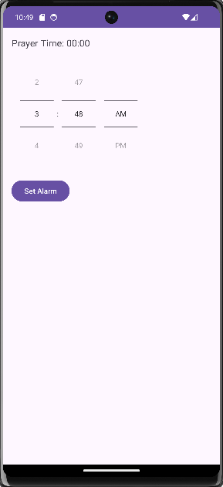
OUTPUT OF SHARED PERFERENCES

Slide 51
VIEW PAGER AND CODES
Welcome Screen
Set Prayer Times
Alarm Settings
Qibla direction
Daily Prayer Tracker

Slide 52
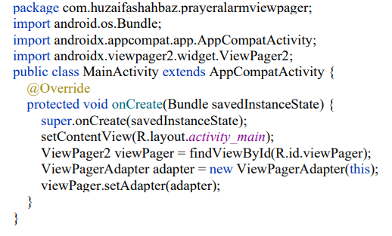
JAVA CODE VIEW PAGER

Slide 53
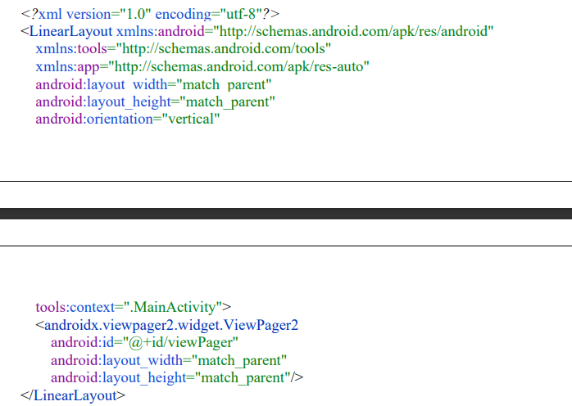
XML CODE VIEW PAGER

Slide 54
JAVA CODE OF PRAYER FRAGMENT
package com.huzaifashahbaz.prayeralarmviewpager; import android.os.Bundle; import androidx.annotation.NonNull; import androidx.annotation.Nullable; import androidx.fragment.app.Fragment; import android.view.LayoutInflater; import android.view.View; import android.view.ViewGroup; import android.widget.TextView; public class PrayerFragment extends Fragment { private static final String ARG_TEXT = "argText"; public static PrayerFragment newInstance(String text) { PrayerFragment fragment = new PrayerFragment(); Bundle args = new Bundle(); args.putString(ARG_TEXT, text); fragment.setArguments(args); return fragment; } @Nullable @Override public View onCreateView(@NonNull LayoutInflater inflater, @Nullable ViewGroup container, @Nullable Bundle savedInstanceState) { return inflater.inflate(R.layout.fragment_prayer, container, false); } @Override public void onViewCreated(@NonNull View view, @Nullable Bundle savedInstanceState) { super.onViewCreated(view, savedInstanceState); TextView textView = view.findViewById(R.id.textView); if (getArguments() != null) { textView.setText(getArguments().getString(ARG_TEXT)); } } }

Slide 55
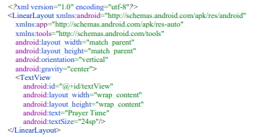
XML CODE OF PRAYER FRAGMENT

Slide 56
JAVA CODE OF VIEWPAGERADAPTER
package com.huzaifashahbaz.prayeralarmviewpager; import androidx.annotation.NonNull; import androidx.fragment.app.Fragment; import androidx.fragment.app.FragmentActivity; import androidx.viewpager2.adapter.FragmentStateAdapter; public class ViewPagerAdapter extends FragmentStateAdapter { private static final int NUM_PAGES = 5; public ViewPagerAdapter(@NonNull FragmentActivity fragmentActivity) { super(fragmentActivity); } @NonNull @Override public Fragment createFragment(int position) { return PrayerFragment.newInstance("Prayer Time " + (position + 1)); } @Override public int getItemCount() { // Return the number of pages return NUM_PAGES; } }

Slide 57
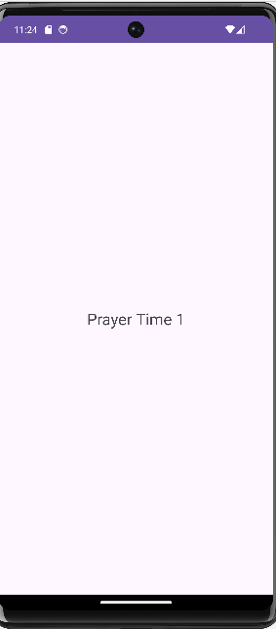
OUTPUT OF VIEW PAGER

Slide 58
Conclusion
In conclusion, this project aims to create an Android prayer alarm application with features like alarm setting, customization, time-zone adjustment, and calendar integration.
It offers a user-friendly interface and efficient code implementation for managing daily prayer routines.

